Slide 1
P641- Classification
Telecommunications Churn
Name: Sukhada Khade
Organization: ExcelR
Domain: Data Science

Slide 2
Business Problem :
Customer churn means customers leaving the telecom company.
High churn leads to revenue loss.
Predicting churn helps the company take early action.
Goal: Understand why customers leave.

Slide 3
Dataset Overview :
Dataset contains telecom customer information
Total customers: 3333
Total features: 19
Target variable: Churn
0 → Customer stayed
1 → Customer left

Slide 4
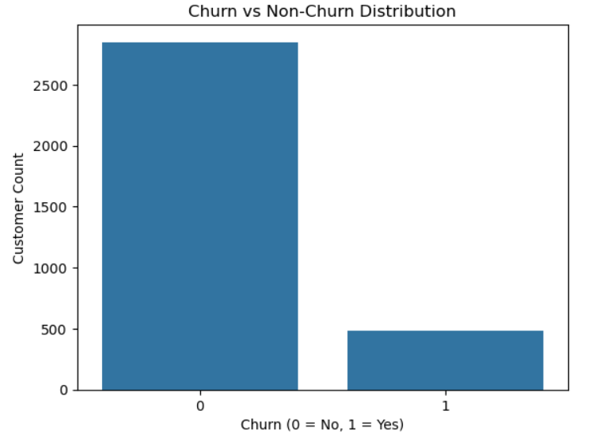
Churn Distribution :
More customers stayed than left
Dataset is imbalanced
Churn customers are fewer but important
Insight:
Accuracy alone is not enough; recall and F1-score are important.

Slide 5
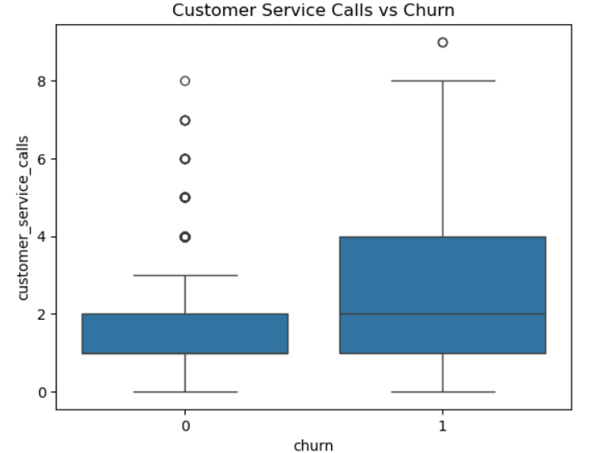
Customer Service Calls vs Churn :
Customers who churned made more service calls.
Frequent complaints indicate dissatisfaction.
Insight:
More customer service calls → higher chance of churn

Slide 6
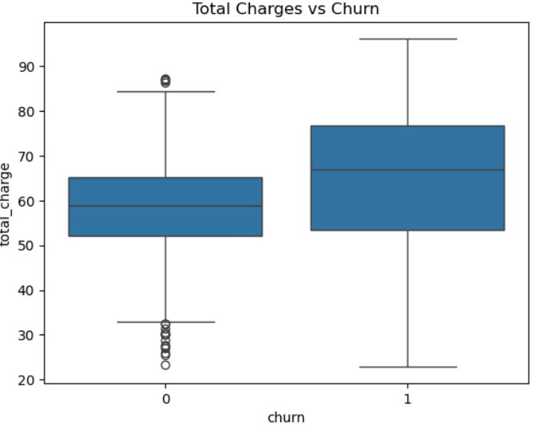
Total Charges vs Churn :
Churned customers have higher total charges.
High bills increase customer dissatisfaction.
Insight:
Higher charges → higher churn risk

Slide 7
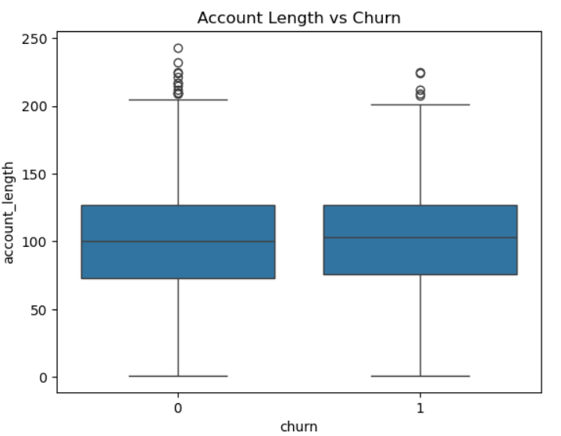
Account Length vs Churn :
New customers churn more
Long-term customers are more loyal
Insight:
Customer loyalty increases with account length

Slide 8
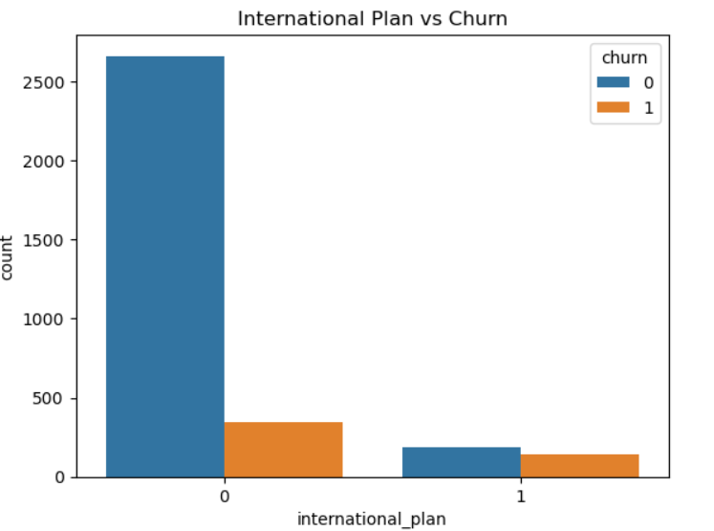
International Plan vs Churn :
Customers with international plans churn more
Possible reason: higher cost or unmet expectations
Insight: International plan users have higher churn tendency

Slide 9
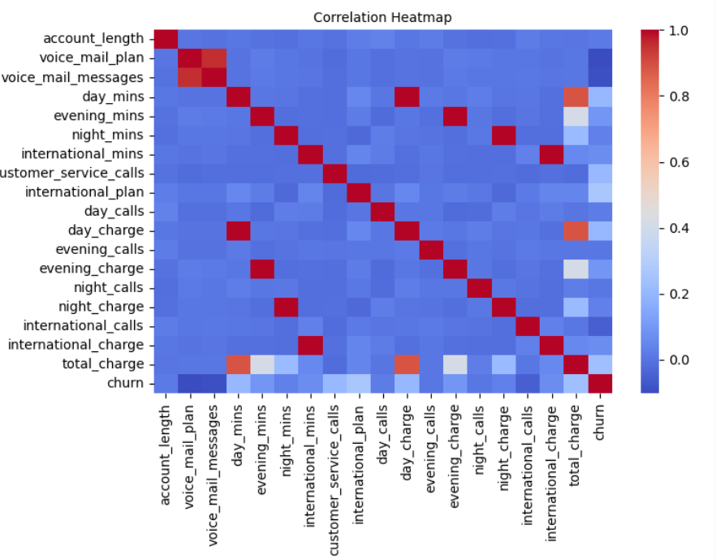
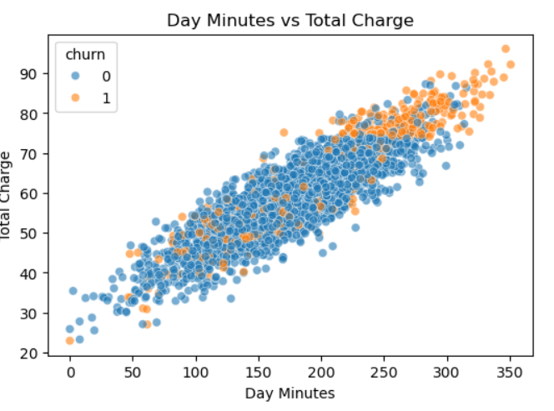
Correlation & Scatter Analysis :
Strong correlation between minutes and charges.
Charges are derived from usage

Slide 10
Conclusion :
EDA helped understand customer behavior clearly.
Identified major factors influencing churn.
Insights will guide preprocessing and model building.
Proper EDA improves prediction accuracy.

